Slide 1
Hmmm...
How about those classifying activities we did?
Was it easy to make up the classification scheme?
Was it easy to follow other people's instructions?
Should it be easy for anyone to follow?
What types of questions make it easier to classify?

Slide 2
Biodiversity
Scientists have identified 1.75 million different species of organisms so far
The number, variety, and genetic variation of different organisms found within a specified geographic region

Slide 3
QUESTIONS TO CONSIDER:
Why so many organisms?
Why should we care?
What purpose do they really serve?
Does our existence really depend on them?

Slide 4
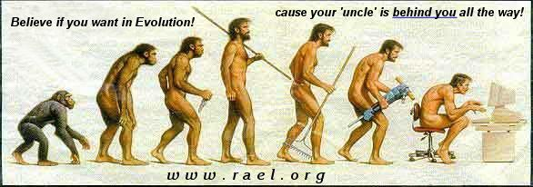
How did we get so much Diversity??
EVOLUTION

Slide 5
Taxonomy

Slide 6
What is taxonomy?
Taxonomy is the branch of biology concerned with the grouping and naming of organisms
Biologists who study this are called taxonomists

Slide 7
How did it start?
People wanted to organize their world so they began grouping, or classifying everything they saw.

Slide 8
Things that swim
Things that fly
Things that crawl
Things that walk on four legs
Things that chew their food
Things that swallow food whole
Things that are toxic

Slide 9
Why classify?
To help us study the earth
To help us organize all the species we discover . . .

Slide 10
To give every species a name based on a standard method so scientists from different countries can talk about the same animal without confusion

Slide 11
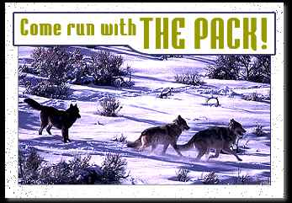

Slide 12
An animal is known by two names…
Canis lupus is the scientific name for a gray wolf.
Canis is the genus name
lupus is the species name
This system uses a binomial nomenclature

Slide 13
Binomial Nomenclature
Bi means two
Nomen means name
A binomial nomenclature is a classification system using two names to identify an organism

Slide 14
Genus…
A genus consists of a group of closely related species
Other animals in the Canis group include dogs and coyotes
The genus name is always Capitalized

Slide 15
Species...
A species consists of animals that can mate and produce fertile offspring
Only grey wolves are known as lupus.
The species name is always lowercase

Slide 16
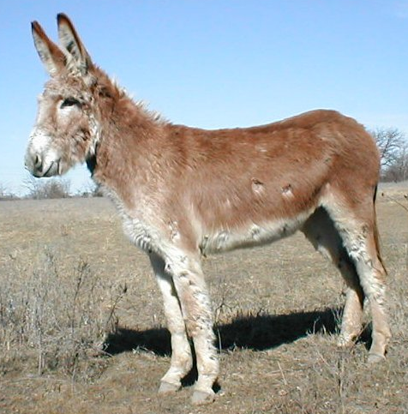
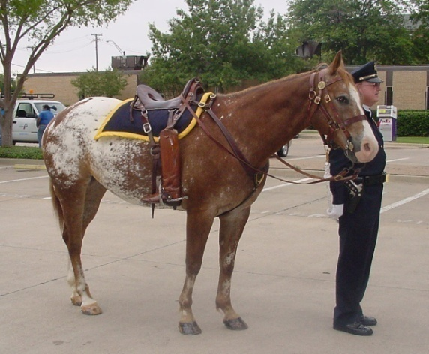
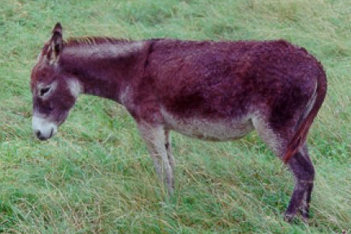
What do you get when you cross a Horse and a Donkey?
A mule, which is sterile!
+
=

Slide 17
Who is Carolus Linnaeus?
Carolus Linnaeus was a Swedish botanist
Developed a 7-level (taxa) classification system based on similarities between organisms

Slide 18
Levels of Classification
Increasing similarity →→→→→→→→→→ | Kingdom | ←←←←←←←←←← Increasing diversity
 | Phylum
 | Class
 | Order
 | Family
 | Genus
 | Species

Slide 19
The Seven Level System
Kingdom
Phylum
Class
Order
Family
Genus
Species
King
Phillip
Called
Oprah
For
Good
Spices

Slide 20
How does it work?
There are 6 broad kingdoms
Every living thing that we know of fits into one of the six kingdoms
Each level gets more specific as fewer organisms fit into any one group

Slide 22
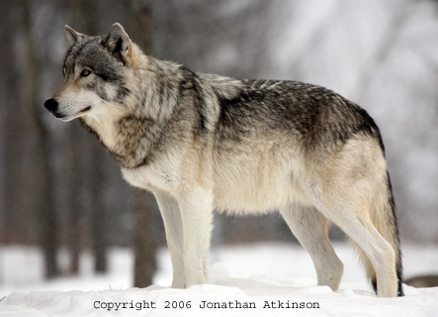
When referring to a particular species, it is correct to give both genus and species together. As an example, here is the taxonomic classification for the grey wolf:
Kingdom: Animalia
Phylum: Chordata
Sub-phylum: Vertebrata
Class: Mammalia
Order: Carnivora
Family: Canidae
Genus: Canis
Species: Canis lupus

Slide 23
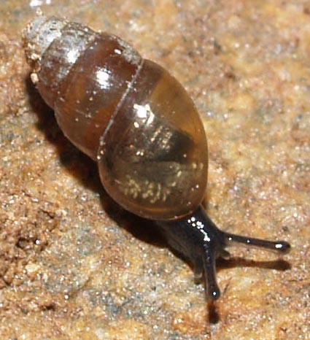
When referring to a particular species, it is correct to give both genus and species together. As an example, here is the taxonomic classification for the grey wolf:
Kingdom: Animalia
Phylum: Mollusca
Sub-phylum: Vertebrata
Class: Gastropoda
Order: Pulmonata
Family: Cochliocopidae
Genus: Cochlicopa
Species: Cochlicopa lubrica

Slide 24
Quick Review
What are the seven taxa or levels?
Who designed the system?
What taxa are organisms named with?

Slide 25
Day 1
Read pages 5-10

Slide 26
Day 2
Dichotomous Keys

Slide 27
Classification - Living Things
There are over 1.7 million species of living things in our world.
As mentioned previously, scientists have arranged all living things into a classification system based on their physical characteristics.
TAXONOMIC (DICHOTOMOUS) KEYS

Slide 28
One method of classifying and identifying objects includes using a taxonomic key, sometimes called a dichotomous key.
A taxonomic key looks at the similarities and differences between objects using a series of paired statements.

Slide 29
The paired statements describe contrasting characteristics (s). it is best to use observable, physical characteristic
You choose one statement out of the pair that happens to be true of the object you are trying to identify.
The statement you choose may ask you to go on to another pair of statements or it may give you the name of the object.

Slide 30
For example - here is a taxonomic key to some common forms
of money you may have handy. Gather some money (penny,
nickel, dime, quarter, $5 bill, etc.). Choose one denomination
of money and try to follow the key to identify what you have.
Although you already know the names of the denominations
of money you are looking at, practice using the taxonomic key.

Slide 31
MONEY TAXONOMIC KEY
1 A. Metal.................................................... go to 2
1 B. Paper.................................................... go to 5
2 A. Brown (copper)........................................ penny
2 B. Silver.................................................... go to 3
3 A. Smooth edge same size as penny ......... dime
3 B. 11 Ridges around the edge..(brown)..................go to 4
4 A. Duck on front......................................... loonie
4 B. Moose head on front..........................................quarter
5 A. Number 5 in the corners............................... $5 bill
5 B. Number 10 in the corners............................... $10 bill

Slide 32
Make a Dichotomous Key: Classroom Activity
As a simple example, you can construct a dichotomous key
to identify people (or another group of items) in a classroom,
using questions based on gender, hair length/color, glasses (or not),
clothing color, etc.
Question 1: Is the person male or female? Question 2: Does the person wear glasses or not? Question 3: Is the person wearing blue jeans or not? etc.
The end of each branch of the key should be a person's name.
A dichotomous key will have enough questions to identify each
member of the group. To test it, you can identify each person in
the group by going through the key and seeing if the right name comes up.

Slide 33
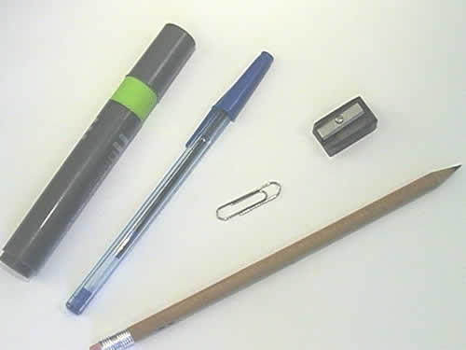
Constructing Dichotomous Keys
As an example, we could construct a key using the
following stationary supplies taken from a student's pencil case.

Slide 34
When constructing a dichotomous key, the first step is to look at the group of objects or organisms and separate them into two groups based on a single distinguishing characteristic.
Then continue to separate each of the groups until each object has its own separate set of characteristics.

Slide 35
Answer key
1 a. long, tubular objects go to #2
b. short, non-tubular object go to #4
2 a. constructed from plastic go to #3
b. constructed from material other than plastic pencil
3 a. green & grey highlighter
b. blue & clear pen
4 a. black & silver pencil sharpener
b. silver paper clip

Slide 36
Levels of Classification
Increasing similarity →→→→→→→→→→ | Kingdom | ←←←←←←←←←← Increasing diversity
 | Phylum
 | Class
 | Order
 | Family
 | Genus
 | Species

Slide 37
The Seven Level System
Kingdom
Phylum
Class
Order
Family
Genus
Species
King
Phillip
Came
Over
For
Good
Spaghetti

Slide 38
Kingdom/Phylum Mind Maps
Introduce Assignment
Read p. 13-23

Slide 39
Credits
Ms Thomas
Biology 11 Addison Wesley
Biology Source 11 Pearson

